Slide 1
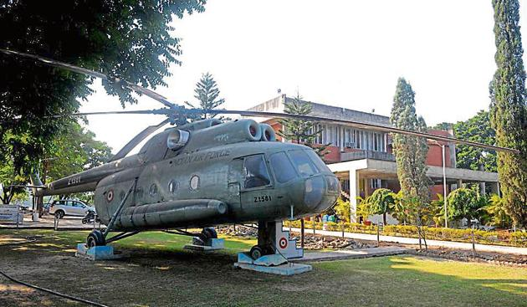


Oral ID : O- 122
Comparative Study of Characterization of SS316L Metal Powders Used in Additive Manufacturing
Presented by:
Shubham D Kamble
College of Engineering Pune
International conference on Advanced Materials, Metallurgy and Manufacturing (ICAMMM- 2022)
Department of Metallurgical and Materials Engineering
Punjab Engineering College (Deemed to be University), Chandigarh (U.T.), India

Slide 2
OUTLINE OF PRESENTATION
Motivation
Experimental Planning.
Results and Discussion.
Conclusion.

Slide 3
MOTIVATION
RAW MATERIAL
Selective Laser Melting (SLM)
Electron Beam Melting (EBM)
Laser Melt Deposition (LMD)
Selective Laser Sintering (SLS)
Additive Manufacturing is a manufacturing process that authorizes the fabrication of the final product using a layer-by-layer deposition of the raw material.
Applications of AM are not only limited to Rapid prototyping.
Metal powders of stainless steel (SS), tungsten(W), Copper (Cu), Co-Cr alloys,Ti alloys are currently in use for manufacturing the components of automotive, aerospace and biomedical applications.
Consistency in the properties of the powders ensures the same mechanical, chemical and thermal properties of every sample to be manufactured.

Slide 4
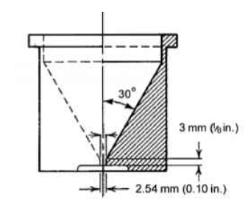
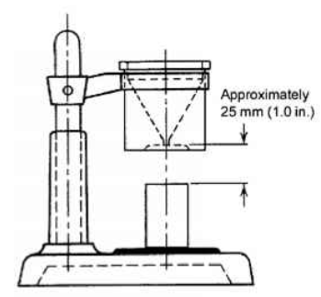
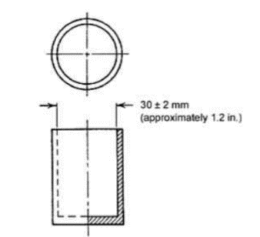
Apparent Density:
It is the mass per unit volume of loosed packed powder.
Apparent density is also called bulk density, packing density and bed density in the Powder bed manufacturing process.
Standard for Apparent Density:- B212.
Instrument used – Hall Flowmeter
Flow rate:-
It is the time required for the powder sample of a standard weight to flow under atmospheric conditions through the funnel of the hall flow meter.
Standard for Apparent Density:- B213.
Instrument used – Hall Flowmeter.
a)
b)
c)
Fig. a) Hall funnel b)Equipment Assembly c) Density cup

Slide 5
Experimental Procedure
Measurand | Instrument/Technique used
Apparent Density | Hall Flowmeter
Flow rate | Hall Flowmeter
Particle size distribution | SEM with ImageJ
Particle Elemental composition | Energy Dispersive Spectroscopy
Particle Morphology | Scanning Electron Microscope

Slide 6
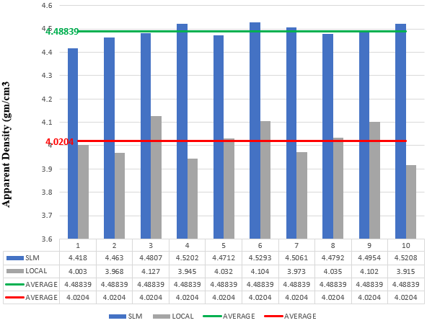
Results and Discussion
Apparent Density:
The results of apparent density tests which are plotted on a bar chart, the standard SS316L powder can be concluded as more spherical than the latter, as the SS316L powder is having an average apparent density of 4.48839 gm/cm3 whereas the local one has 4.0204 gm/cm3.
Apparent density is directly proportional to the particle size and particle shape.
Fig. Apparent density plots

Slide 7
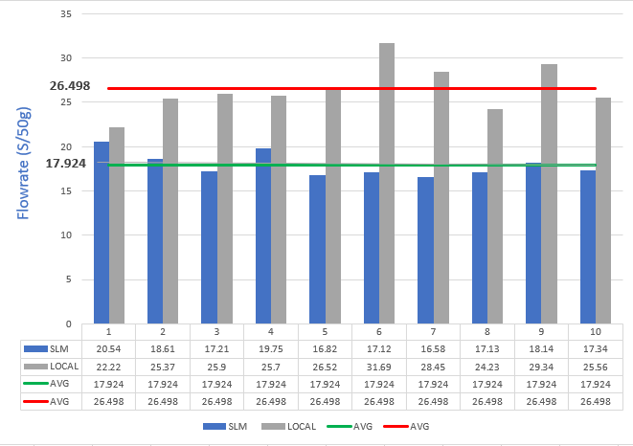
Flowrate:-
The average time required for the SLM powder sample to flow through the nozzle is only 17.924 secs for 50 grams of powder, whereas in the case of local powder it is about 26.498 secs for 50 grams of powder
The more the spherical powder more will be the flow rate, so we can say that the standard powder sample is having more sphericity compared to the local powder sample
Fig. Flowrate plots.

Slide 8
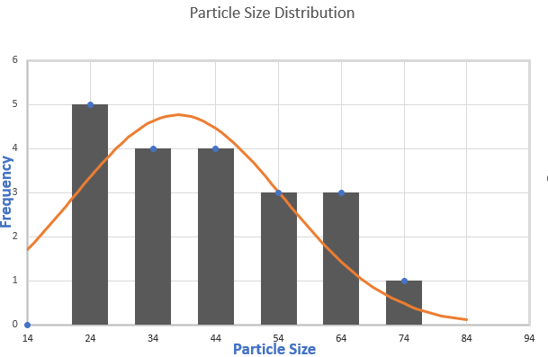
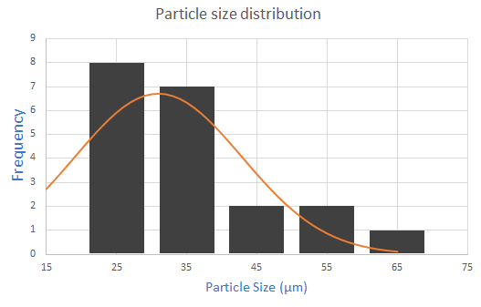
Particle size distribution analysis :-
a)
b)
c)
d)
Fig. a) SEM image of an SLM standard powder sample with 500X magnification. b) SEM image of local powder sample with 500X magnification c) SLM powder with a mean size of 37.9876(µm) d) Local powder with the mean size of 30.9549 (µm)

Slide 9
Particle size distribution analysis :-
The standard SS316L powder had an average particle size of 37.9876 µm. In which very few particles were smaller than the average particle size, whereas for the local SS316L powder the average particle size was found to be 30.9549 µm, in which many of the particles are found to be below the 25 µm size.
It can be concluded that the powder which is having a wider size distribution from 14- 71 µm has good flowability than the powder with 17-61 µm size distribution.

Slide 10
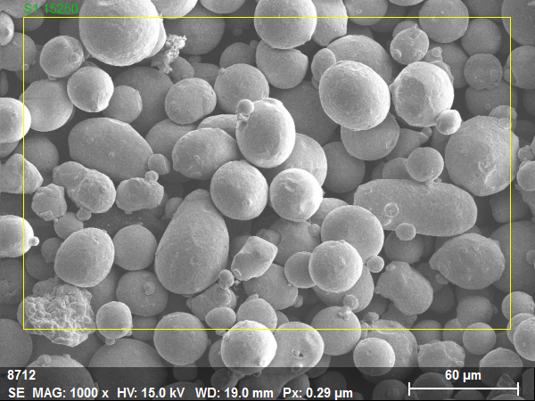
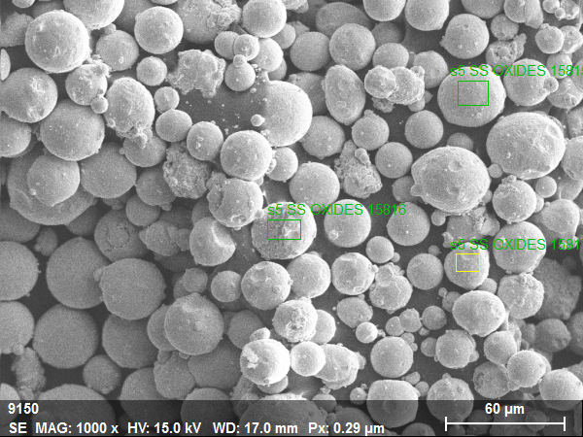
EDS RESULTS:
a)
b)
c)
d)
Fig. a) Area selected for SEM-EDS analysis for standard SS316L b) Energy Dispersive Spectra for the standard SS316L powder. C) Area selected for SEM-EDS analysis for local SS316L d) Energy Dispersive Spectra for the local SS316L powder.

Slide 11
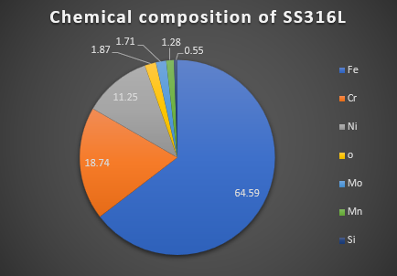
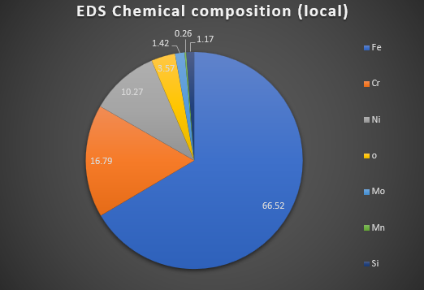
Elemental Composition:-
Fig. EDS results of elemental composition for Standard SS316L.
SEM-EDS performed for both the powder samples revealed that Fe content is smaller by 1.96% in the standard sample whereas it is having increased amount of Cr and Ni of about 1.95% and 0.98% compared to the local powder sample. This increased amount of Cr and Ni provides good corrosion resistance and lesser friction properties.

Slide 12
Conclusion
Bonding of satellite particles and dimple formation observed in the SEM morphology results suggest that the local powder particles were rougher and distributed in the small particle size end (<20µm), which caused its apparent density (4.0204 gm/cm3) to decrease and flowrate (26.498 sec/50gm) to increase.
The EDS results revealed that the SLM powder is having more amount of Cr (18.74%) and Ni (11.25%) content which will increase the corrosion resistance of the final 3D printed part.
Particles with a more spherical shape and lesser size distribution range are desired, which influences both apparent density and flow rate.
Higher apparent density, lower flow rate and more amount of corrosion-resistant elements were desired for the metal powder to be standard.

Slide 13
THANK YOU

